Slide 1
SQL SELECT Statement
Muhammad Sadeequllah

Slide 2
SELECT Statement Syntax
SELECT [column names’ list]
FROM table name
[WHERE predicate/condition]

Slide 3
SELECT Query (Example)
SELECT au_fname, au_lname
FROM authors

Slide 4
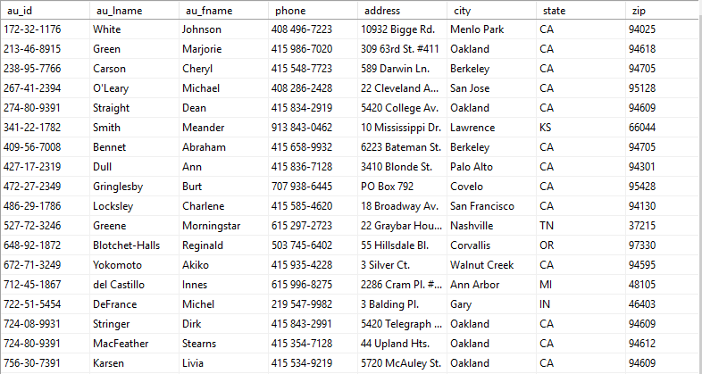
SELECT Query (selecting columns)
SELECT au_fname, au_lname
FROM authors

Slide 5
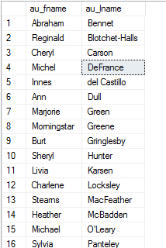
SELECT Query (selecting columns)
SELECT au_fname, au_lname
FROM authors

Slide 6
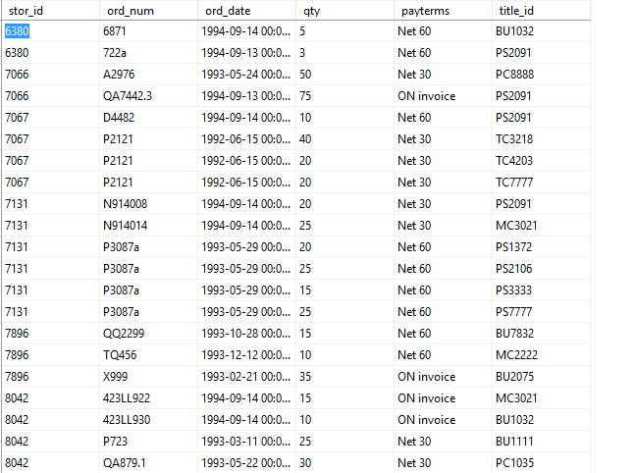
SELECT Query (selecting all columns)
Sales table

Slide 7
SELECT Query (selecting all columns)
SELECT stor_id, ord_num, ord_date, qty, payterms, title_id
FROM sales

Slide 8
SELECT Query (selecting all columns)
SELECT stor_id, ord_num, ord_date, qty, payterms, title_id
FROM sales
SELECT *
FROM sales

Slide 9
SELECT Query (selecting all columns)
SELECT stor_id, ord_num, ord_date, qty, payterms, title_id
FROM sales
SELECT *
FROM sales
Note: The above two queries are equal because * (called wild card character) represents all column names

Slide 10
WHERE clause operators (relational)
Operator | Condition Tested
= | Tests for equality between two expressions
<> | Tests whether two expressions are not equal to each other
!= | Tests whether two expressions are not equal to each other (same as <>)
> | Tests whether one expression is greater than the other
>= | Tests whether one expression is greater than or equal to the other
!> | Tests whether one expression is not greater than the other
< | Tests whether one expression is less than the other
<= | Tests whether one expression is less than or equal to the other
!< | Tests whether one expression is not less than the other

Slide 11

WHERE clause operators
SELECT *
FROM employee
WHERE lname = "Latimer"

Slide 12
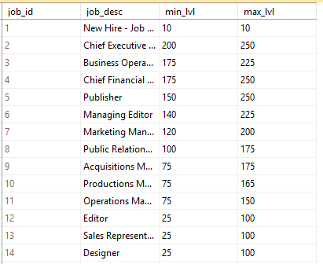
WHERE clause operators
SELECT job_desc
FROM jobs
WHERE job_id <> 1

Slide 13
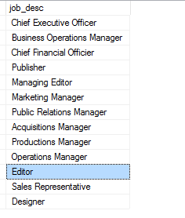
WHERE clause operators
SELECT job_desc
FROM jobs
WHERE job_id <> 1

Slide 14
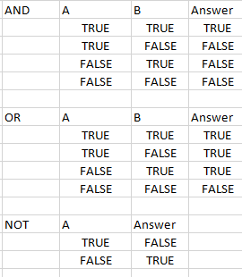
WHERE clause operators (Logical)
Truth tables of boolean logical operators
Definition
AND (Binary Operator)
True if both operands are true
and false otherwise
OR (Binary Operator)
False if both operands are false
and true otherwise
OR (Unary Operator)
Reverses binary value from true to false and vice versa

Slide 15
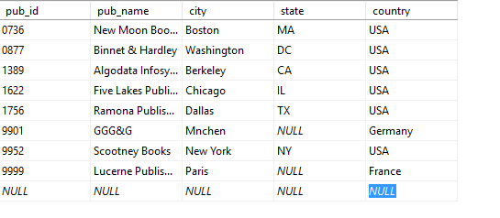

WHERE clause operators (Logical)
SELECT pub_name, state
FROM publishers
WHERE state = 'DC' OR
state = 'MA'

Slide 16
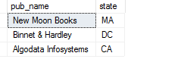
WHERE clause operators (Logical)
SELECT pub_name, state
FROM publishers
WHERE state = 'DC' OR
state = 'MA' OR
state = 'CA'

Slide 17
WHERE clause operators (IN)
SELECT pub_name, state
FROM publishers
WHERE state IN('DC', 'MA', 'CA')

Slide 18
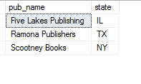
WHERE clause operators (NOT)
SELECT pub_name, state
FROM publishers
WHERE state NOT IN('DC', 'MA', 'CA')

Slide 19
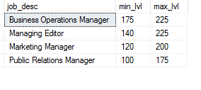
WHERE clause operators (Logical)
SELECT job_desc, min_lvl, max_lvl
FROM jobs
WHERE min_lvl >= 100 AND
max_lvl <= 225

Slide 20
WHERE clause operators (Logical)
SELECT job_desc, min_lvl, max_lvl
FROM jobs
WHERE min_lvl >= 100 AND
max_lvl <= 225

Slide 21
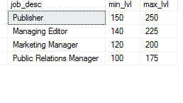
WHERE clause operators (Logical)
SELECT job_desc, min_lvl, max_lvl
FROM jobs
WHERE min_lvl >= 100 AND
min_lvl <= 150

Slide 22
WHERE clause operators (BETWEEN)
SELECT job_desc, min_lvl, max_lvl
FROM jobs
WHERE min_lvl BETWEEN 100 AND 150

Slide 23
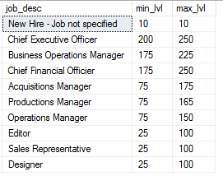
WHERE clause operators (NOT)
SELECT job_desc, min_lvl, max_lvl
FROM jobs
WHERE min_lvl NOT BETWEEN 100 AND 150

Slide 24
SELECT Column Aliases
SELECT au_fname, au_lname
FROM authors

Slide 25
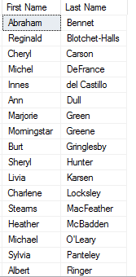
SELECT Column Aliases
SELECT au_fname AS "First Name", au_lname AS "Last Name"
FROM authors

Slide 26
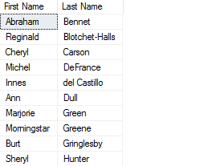
SELECT TOP Argument
SELECT TOP 10 au_fname AS "First Name", au_lname AS "Last Name"
FROM authors
23 records in total

Slide 27

SELECT TOP Argument
SELECT TOP 10 PERCENT au_fname AS "First Name", au_lname AS "Last Name"
FROM authors

Slide 28
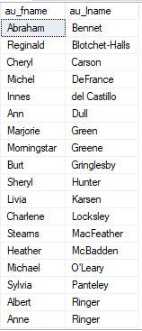
SELECT Distinct Argument
SELECT DISTINCT au_fname, au_lname
FROM authors
All 23 rows returned. No Distinct/unique record

Slide 29
Relational JOIN Statement
Relational JOINs are used when we want to retrieve data from two or more tables
There are two are more table names in the FROM clause
Relational JOINs are the most processing intensive SQL statements

Slide 30


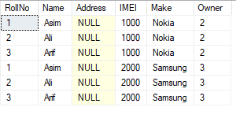
Relational JOIN (CROSS JOIN)
Student Table
Phone Table
CROSS JOIN Table
SELECT *
FROM Student, Phone
SELECT *
FROM Student CROSS JOIN Phone

Slide 31
Relational JOIN (Natural JOIN)
Involves an equality condition, that’s why also called equi-join
Selects only those records from CROSS JOIN where Primary Key Foreign Key value matches
Actually shows/displays child records against their parent records

Slide 32

Relational JOIN (Natural JOIN)
SELECT *
FROM Student, Phone
WHERE rollNo = Owner
SELECT *
FROM Student JOIN Phone ON rollNo = Owner
Natural JOIN of Student and Phone

Slide 33

Relational JOIN (Natural JOIN)
SELECT RollNo, Name, Make
FROM Student, Phone
WHERE rollNo = Owner
SELECT RollNo, Name, Make
FROM Student JOIN Phone ON rollNo = Owner
Natural JOIN of Student and Phone

Slide 34

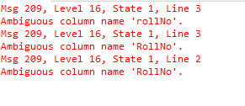
Relational JOIN (Table Names Aliases)
SELECT RollNo, Name, Make
FROM Student, Phone
WHERE rollNo = RollNo
SELECT RollNo, Name, Make
FROM Student JOIN Phone ON rollNo = RollNo
Phone with FK column name same as PK name
Error message

Slide 35
Relational JOIN (Table Names Aliases)
SELECT Student.RollNo, Student.Name, Phone.Make
FROM Student, Phone
WHERE Student.rollNo = Phone.RollNo
SELECT Student.RollNo, Student.Name, Phone.Make
FROM Student JOIN Phone ON Student.rollNo = Phone.RollNo
Phone with FK column name same as PK name
SELECT s.RollNo, s.Name, p.Make
FROM Student s, Phone p
WHERE s.rollNo = p.RollNo
SELECT s.RollNo, s.Name, p.Make
FROM Student s JOIN Phone p ON s.rollNo = p.RollNo

Slide 36

Relational JOIN (LEFT OUTER JOIN)
SELECT s.RollNo, s.Name, p.Make
FROM Student s LEFT OUTER JOIN Phone p
ON s.rollNo = p.RollNo

Slide 37

Relational JOIN (RIGHT OUTER JOIN)
SELECT s.RollNo, s.Name, p.Make
FROM Student s RIGHT OUTER JOIN Phone p
ON s.rollNo = p.RollNo

Slide 38
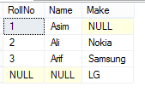
Relational JOIN (FULL OUTER JOIN)
SELECT s.RollNo, s.Name, p.Make
FROM Student s FULL OUTER JOIN Phone p
ON s.rollNo = p.RollNo

Slide 39
SQL SELECT (LIKE Statement)
Used for pattern matching
<match_expression> LIKE <pattern>
Match expression is normally a column name representing a value
Value is normally character string
Pattern is a string with wild card characters
Wild card characters a keyboard characters carry special meaning when used in pattern strings

Slide 40
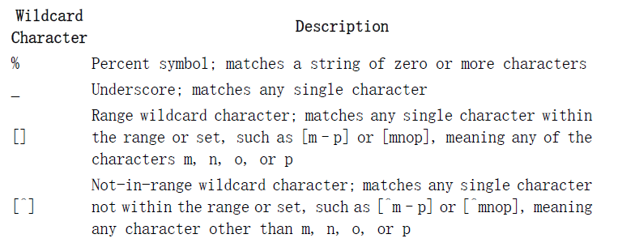
SQL SELECT (LIKE Statement)

Slide 41
SQL Functions
Scalar Functions
Act upon single row of a table and return a single value
E.g. DATE, CONVERT, SUBSTR, VAR etc
Group/Aggregate Functions
Act upon one or more rows of a table and return a single value
SUM, AVG, MINetc

Slide 42
SQL Aggregate Functions
Five Common Aggregate Functions
COUNT: returns total number of rows
SUM: used to return arithmetic sum of all the values of a numerical column
AVG: returns arithmetic mean of all the values of a numerical column
MIN: returns the minimum value of all the values of a numerical column
Max: returns the maximum value of all the values of a numerical column

Slide 43

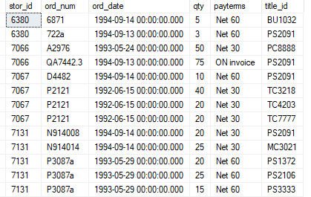

SQL Aggregate Functions (SUM)
SELECT SUM(qty)
FROM sales
SELECT SUM(qty) "Total titles"
FROM sales

Slide 44

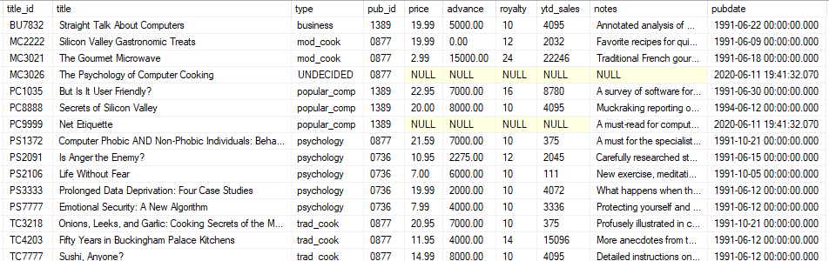
SQL Aggregate Functions (AVG)
SELECT AVG(price) AS "Average Price"
FROM titles

Slide 45

SQL Aggregate Functions (COUNT)
SELECT COUNT(*) AS “Total Tiles"
FROM titles
SELECT COUNT(title_id) AS “Total Tiles"
FROM titles
SELECT type, pub_id, AVG(price) AS "Average Price"
FROM titles
GROUP BY type, pub_id

Slide 46

SQL Aggregate Functions (MIN)
SELECT MIN(price) AS “Minimum Price"
FROM titles

Slide 47

SQL Aggregate Functions (MAX)
SELECT MAX(price) AS “Maximum Price"
FROM titles
SELECT type, pub_id, AVG(price) AS "Average Price"
FROM titles
GROUP BY type, pub_id

Slide 48
SQL Aggregate Functions with GROUP BY
GROUP BY: it is used to calculate aggregate function output for groups, subgroups, sub-subgroups etc
Column(s) in the SELECT line without aggregate functions must be included in GROUP BY clause
GROUP BY also uses HAVING clause to restrict group-subgroup output
HAVING, contrary to WHERE clause which restricts only records to be included in the output, restricts aggregate output to be included in output
HAVING is used only when GROUP BY is used
A single query can have both the WHERE clause as well as the HAVING clause

Slide 49
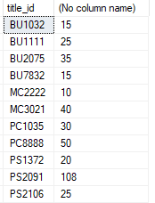
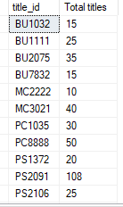
SQL Aggregate Functions (SUM with Subgroups)
SELECT SUM(qty) "Total titles"
FROM sales
SELECT title_id, SUM(qty)
FROM sales
GROUP BY title_id
SELECT title_id, SUM(qty)
"Total titles"
FROM sales
GROUP BY title_id

Slide 50
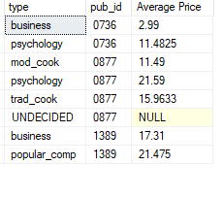
SQL Aggregate Functions (AVG with Subgroups)
SELECT AVG(price) AS "Average Price"
FROM titles
SELECT type, pub_id, AVG(price) AS "Average Price"
FROM titles
GROUP BY type, pub_id

Slide 51
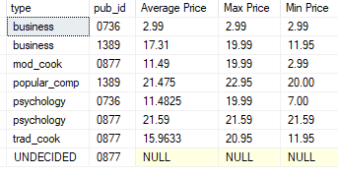
SQL Aggregate Functions with multiple Subgroups and ORDER BY
SELECT type, pub_id, AVG(price) AS "Average Price", Max(price) "Max Price", Min(price) "Min Price"
FROM titles
GROUP BY type, pub_id
Order By type, pub_id

Slide 52
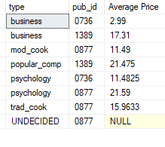
SQL Aggregate Functions with Subgroups and ORDER BY
SELECT type, pub_id, AVG(price) AS "Average Price"
FROM titles
GROUP BY type, pub_id
SELECT type, pub_id, AVG(price) AS "Average Price"
FROM titles
GROUP BY type, pub_id
Order By type, pub_id

Slide 53
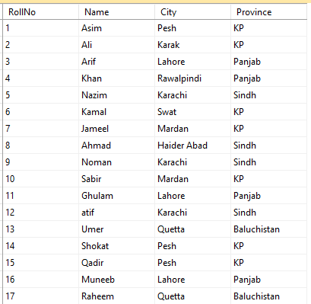
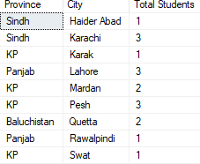
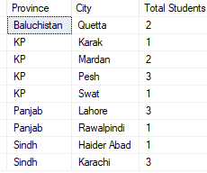
SQL Aggregate Functions with Subgroups and ORDER BY (Another Example)
SELECT Province, City, COUNT(Roll#) AS “Total Students"
FROM Student
GROUP BY Province, City
SELECT Province, City, COUNT(Roll#) AS “Total Students"
FROM Student
GROUP BY Province, City
Order By Province, City

Slide 54
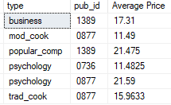
SQL Aggregate Functions with Subgroups, ORDER BY and HAVING
SELECT type, pub_id, AVG(price) AS "Average Price"
FROM titles
GROUP BY type, pub_id
Order By type, pub_id
SELECT type, pub_id, AVG(price) AS "Average Price"
FROM titles
GROUP BY type, pub_id
HAVING AVG(price) > 3
Order By type, pub_id

Slide 55
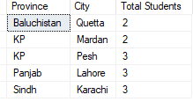
SQL Aggregate Functions with Subgroups, ORDER BY and HAVING (Another Example)
SELECT Province, City, COUNT(RollNo) AS "Total Students"
FROM Student
GROUP BY Province, City
Order By Province, City
SELECT Province, City, COUNT(RollNo) AS "Total Students"
FROM Student
GROUP BY Province, City
HAVING COUNT(RollNo) >= 2
Order By Province, City

Slide 56
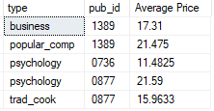

SQL Aggregate Functions with Subgroups, WHERE, ORDER BY and HAVING
SELECT type, pub_id, AVG(price) AS "Average Price"
FROM titles
Where type != 'mod_cook'
GROUP BY type, pub_id
HAVING AVG(price) > 3
Order By type, pub_id
SELECT Province, City, COUNT(RollNo) AS "Total Students"
FROM Student
Where Province != ‘Panjab’
GROUP BY Province, City
HAVING COUNT(RollNo) >= 2
Order By Province, City

Slide 57
End of SELECT Statement

